Slide 1
FUNDAMENTALS OF MACHINE LEARNING FINAL PROJECT Analyzing US Energy Data Using Clustering and Regression: A Case Study with PUDL
YESWANTH SIRIPURAPU
ID.NO: 811298603
GUIDED BY
Li Liu, Ph.D.

Slide 2
INTRODUCTION
The PUDL project provides an open-source data processing pipeline for analyzing energy statistics in the United States. To study the US energy market, we shall use EIA-923 Schedule 2, Part A.
Using clustering and other analytical tools, we hope to find patterns and links in the data. We hope to share insights for a more sustainable and cleaner energy future.
This research demonstrates the usefulness of data analysis in informing energy industry decision-making.

Slide 3
STATEMENT OF THE PROBLEM
Accessing and working with US government energy data is challenging due to its large volume, variety of formats, and missing data.
This project uses PUDL to clean and unify data, then analyzes fuel costs and purchases of US power plants in EIA-923 Schedule 2, Part A.
Our objective is to identify patterns and clusters among power plants to achieve a clean energy future.
We'll use cluster approaches and make sure our variables are relevant and data is correctly sampled.

Slide 4
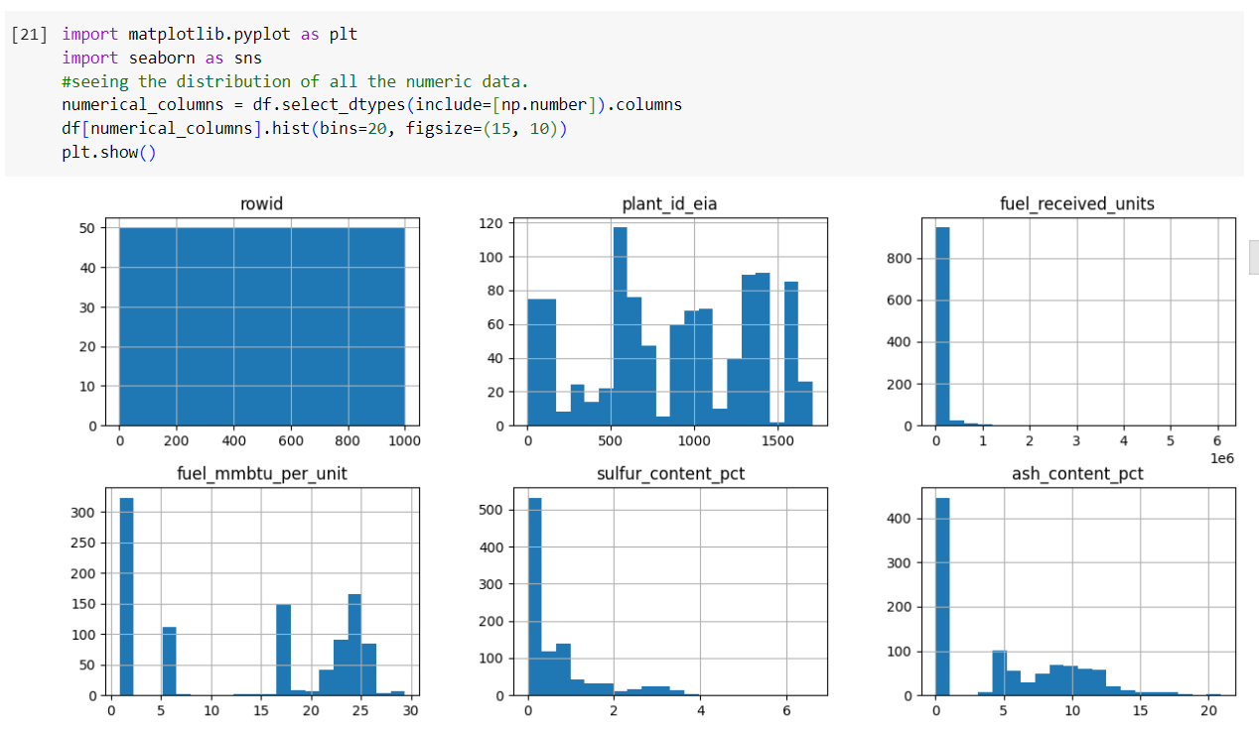
METHODOLOGY
A typical strategy for determining the ideal number of clusters for a particular dataset is to employ a technique known as the elbow method. The elbow approach entails graphing the number of clusters versus a metric indicating how effectively the clustering algorithm performs. The plot usually shows a decreasing curve that levels off at some point as the number of clusters grows. The elbow point is the point at which the curve levels off and corresponds to the optimal number of clusters.

Slide 5
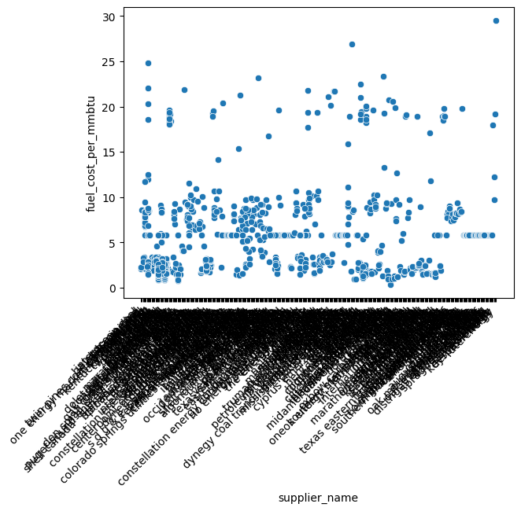
ANALYSIS
The elbow method is implemented using the facto extra package's function. The function is used twice, once using the silhouette approach and once using the within-cluster sum of squares (wss) method. The silhouette approach computes the average silhouette width for various k (number of clusters) values, whereas the wss method computes the within-cluster sum of squares for various k values.

Slide 6
CONTINUTION...
We employed K-means clustering in this investigation, which is a popular unsupervised learning approach for partitioning a dataset into K clusters.
K-means clustering is very beneficial when no prior information of the data structure is available.
We can get insights into the underlying patterns and linkages in the data by splitting it into clusters, which can influence future analysis and decision-making. We utilized the k means function from R's stats package to do K-means clustering on our dataset.
We ran the procedure for several K values ranging from 2 to 10. We ran the algorithm 25 times for each value of K to prevent getting caught in a local minimum.

Slide 7
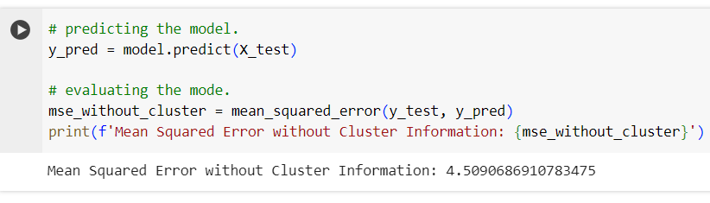
RESULTS
We can find patterns and links in the data and potentially reveal factors that effect electricity generation in the United States by utilizing clustering methods and other approaches discussed in class.
The research may indicate clusters of power plants with comparable fuel contracts, purchases, and expenditures, which may aid in identifying areas for efficiency improvements. It may also indicate any relationships between various variables, such as the one between fuel type and cost.

Slide 8
CONCLUSION
The Clean Power Future cluster was chosen as the best for establishing a clean energy future in the United States based on our examination of monthly fuel contract data from EIA-923 Schedule 2, Part A.
This cluster is mostly powered by natural gas, has lower fuel costs, and is concerned with pollution reduction.
The Thermogenic Plants cluster is not environmentally friendly because it relies heavily on coal. The demand for natural gas is extremely strong.
Our study offers policymakers and scholars crucial insights into a greener, more sustainable energy future.

Slide 9
THANK YOU

